Slide 1
Introduction to Grammar
Hauser Jr. Sr. High School | English Language Arts

Slide 2
What is grammar?
Grammar is the master lexicon (vocabulary/dictionary) of any language.
Linguistics is the study of languages.
In linguistics and grammar, there are two important things we study:
1. Syntax: the structure or word order of a language
2. Semantics: the meaning of words or combinations of words

Slide 3
The Structure
S-V-O
In the English language, the common syntax or order is:
Subject (Noun)
Verb (Verb)
Object (Noun)

Slide 4
Parts of a Sentence: NOUN

Slide 5
Parts of a Sentence: VERB

Slide 6
Type of Verb?
Transitive or Intransitive?
Transitive verb: an action verb that sends its action to a noun or pronoun (the direct object of the sentence)
Intransitive verb: a verb without a corresponding direct object

Slide 7
Type of Verb?
Transitive or Intransitive?
Ask yourself: Is there a direct object?
Yes= Transitive
No= Intransitive

Slide 8
Parts of a Sentence: OBJECT

Slide 9
Parts of a Sentence: Direct Object

Slide 10
Part of a Sentence: Indirect Object

Slide 11
Part of a Sentence: Adjective

Slide 12
Part of a Sentence: Adverb

Slide 13
Part of a Sentence: Preposition

Slide 14
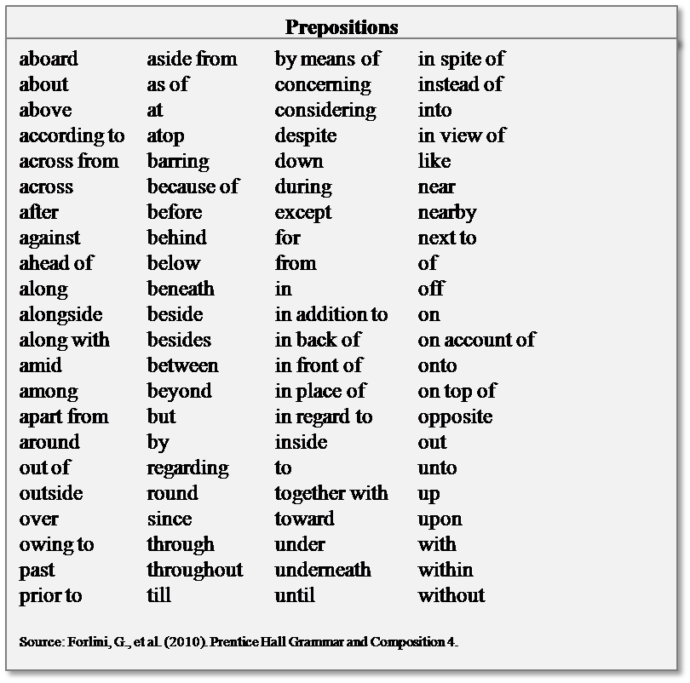
Prepositions

Slide 15
Conjunctions
Conjunctions connect clauses or sentences together.
Examples: and, but, or, yet, however, etc.

Slide 16
Interjections
Interjections are also called exclamations. These are used to express emotion or sentiment.
Examples: Yeah! Hey! Oh snap!

Slide 17
Articles
Articles=
A
An
The

Slide 18
Gerund
Here is one that you probably haven’t heard of before. A gerund is a noun made from verb by adding “ing”.
Examples: I did the reading. The swimming was rough. Eating ice cream is amazing.

Slide 19
Grammar Help?
http://www.chompchomp.com

